Slide 1
What’s new in .NET Core
Martin Ullrich
Notes:
So what is .NET?

Slide 2
Evolution of .NET Core
1.0 – 2016
  Initial release
  Cross-Platform web applications with ASP.NET Core
  Open source
2.0 – 2017
  .NET Standard 2.0
  Compatibility shims for .NET Framework DLLs / packages
2.1 – 2018
  Windows Compatibility Pack
  …

Slide 3
.NET Core 2.1 Major Features
.NET Core
  Lazy Loading
  Value conversions
  Query types
  Data seeding
ASP.NET Core
Global Tools
Span<T>
Sockets
HttpClient Performance
Windows Compatibility Pack
EF Core
  HTTPS
  Razor UI as a library
  HttpClientFactory
  ASP.NET Core SignalR

Slide 4
.NET Core 2.2 Major Features
.NET Core
  Spatial extensions
  Collections of owned entities
  Query tags
ASP.NET Core
Multi-tiered JIT compilation
SQL token authentication
Runtime event listeners
EF Core
  Template updates
  (Bootstrap 4, Angular 6)
  Better OpenAPI integration
  + code analyzers
  IIS in-process hosting (opt-in)
  HTTP/2 (preview)
  Health checks
  Endpoint routing (opt-in)
  SignalR Java client
  …

Slide 5
.NET Core 3.0

Slide 6





.NET Core
3
2
.NET Core 3 expands supported workloads to include Windows Desktop, IoT & AI
.NET Core is perfectly suited for the requirements of cloud-native, cross-platform workloads
WEB
CLOUD
DESKTOP
IoT
AI
.NET CORE
.NET CORE 3
LIBRARIES
INFRASTRUCTURE
RUNTIME COMPONENTS
COMPILERS
LANGUAGES
Notes:
ANIMATED SLIDE – shows progression of entire .NET platform into .NET Core specific workloads.
.NET Core is our cross-platform, open source implementation of .NET and is perfectly suited for requirements of cloud-native, cross-platform services. We’ve made significant investments in the core performance as well as the web stack so that you can easily take advantage of cloud patterns and scale.
.NET Core 3 will expand on the supported workloads to include IoT, AI and Windows Desktop.

Slide 7
.NET Core 3.0 scenarios
Cloud & Web
IoT
  Better behavior in constrained environments
  Small containers
AI
  Performance improvements
  Hardware intrinsics – APIs for AVX, SSE, FMA
  Groundwork for ML.NET
Windows Desktop
  Open source WinForms & WPF

Slide 8
WPF & WinForms
Windows only
  Minimum Windows version not yet announced
Mix WPF & WinForms with UWP controls
  “XAML Islands”
  WinUI Library
Port “still standing” .NET Framework Apps to Core
  You can use the latest APIs and all C# 8
Clean cut allows much needed breaking changes
  e.g. High DPI support in WinForms

Slide 9
Demo
Windows Desktop Applications
Notes:
In-Browser tutorial:
www.dot.net → Get Started → Select In-browser tutorial
https://www.microsoft.com/net/learn/in-browser-tutorial/1
-- Have the class walk through some of the lessons.

Slide 10
What else?

Slide 11
Enables C# 8 features
Some C# 8 features require runtime changes
  First runtime change since Generics
Others just new APIs
  BUT: Like Span<T>, the benefit will be BCL classes supporting these APIs

Slide 12
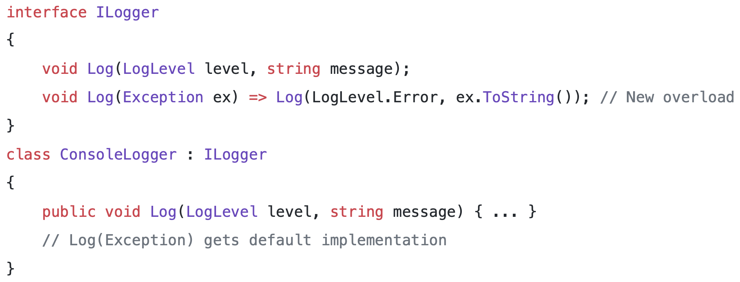
C# 8: Default Interface Members

Slide 13
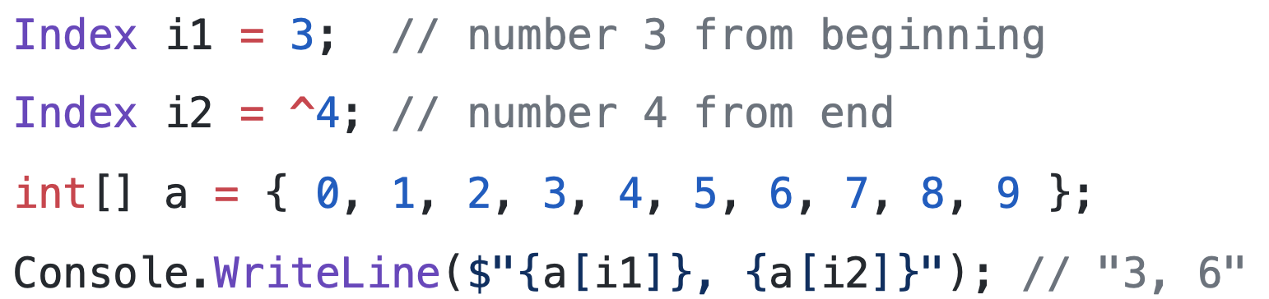
C# 8: Ranges and Indices

Slide 14
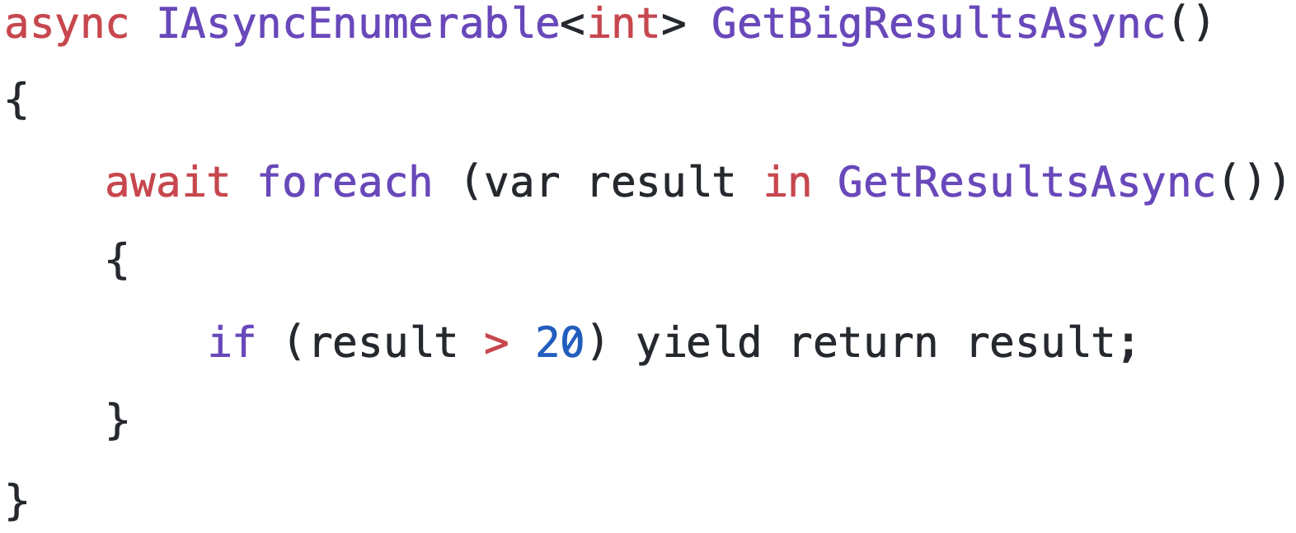
C# 8: Async Streams

Slide 15
More API Improvements
Fast JSON Serialization
  Utf8JsonReader in preview 1
  Writing, POCO de-/serialization planned
  ASP.NET Core will have optional JSON.NET integration for compatibility
Serial Port APIs on Linux
  Was limited to Windows before
GPIO, PWM, SPI and I2C APIs
  System.Device.GPIO NuGet package supported for .NET Core 2.1+
ARM64 Linux support

Slide 16
More API Improvements
TLS 1.3 & OpenSSL 1.1.1 supported on Linux
  Support for OpenSSL 1.0.2, 1.1.0 and 1.1.1 – whichever is installed
  1.1.1: SslStream and HttpClient will use TLS 1.3 by default
Cryptography APIs
  New ciphers: AES-GCM and AES-CCM
  Load / Save keys in DER format (no more X509 cert needed)
MetadataLoadContext
  Replacement for .NET Framework’s “ReflectionOnlyLoad()”
  Available as System.Reflection.MetadataLoadContext package for .NET Standard 2.0

Slide 17
Lots of minor API improvements
Brotli support built-in to HttpClient
ThreadPool.UnsafeQueueWorkItem(IThreadPoolWorkItem)
Unsafe.Unbox
CancellationToken.Unregister
Complex arithmetic operators
Socket APIs for TCP keep alive
StringBuilder.GetChunks
IPEndPoint parsing
RandomNumberGenerator.GetInt32
(these are just the preview 1 ones…)

Slide 18
Tooling Improvements

Slide 19
Demo
Local Tools
Notes:
In-Browser tutorial:
www.dot.net → Get Started → Select In-browser tutorial
https://www.microsoft.com/net/learn/in-browser-tutorial/1
-- Have the class walk through some of the lessons.

Slide 20
More Tooling Improvements
Build “more like publish”
  Contains all referenced NuGet assemblies
  ”dotnet build” output copyable to other machines
  Some features like razor compilation still require a publish operation (ASP.NET Core)
Executables by default
  Build output contains executable for platform built on
  “dotnet the.dll” still works cross-platform
Single-executable publish (planned)
  Merge all managed and native assemblies to a single large executable

Slide 21
Entity Framework Core

Slide 22
Entity Framework Core Roadmap for 3.0
EF 6 (classic) will run on .NET Core 3.0
  Allows to port existing applications using features of classic EF
Cosmos DB support
LINQ improvements
C# 8.0 support
Reverse engineering database views into query types
Property bag entities

Slide 23
ASP.NET Core

Slide 24
ASP.NET Core Roadmap for 3.0
Default optional / preview features from 2.2
  In-process hosting, HTTP/2, endpoint routing
.NET Core 3.0 only
  Support lifecycle for 2.1 on .NET Framework extended indefinitely to match classic MVC
Leaner core framework
  Entity Framework Core and integrations are NuGet packages
More 3rd party integrations
  Authentication – IdentityServer already in 2.2 (templates TBD)
  NSwag, Swashbuckle, AutoRest for API & Client generation experience
  Further health checks integrations

Slide 25
ASP.NET Core 3.0: Razor Components
Blazor programming model integrated into ASP.NET Core
Runs server-side on .NET Core
Handle client UI interactions using SignalR
Same code can run client-side on WebAssembly with no code changes
WebAssembly support remains experimental while runtime matures
Razor Components shipping in .NET Core 3.0

Slide 26
Port to Core?

Slide 27
To port or not to port
Port when
  Porting provides business value
  Actively developed project
  You want to use new features and improvements
Don’t port when
  No business value
  “maintenance mode” project

Slide 28


